Slide 1

A data analysis of the US.Patent and Trademark Office

Slide 2




Team
Tarek Cheaito
Rohana Habib
Himanshu Mayank
Xénia Sozonoff

Slide 3

Summary
Introduction
Exploratory Analysis
Average centralities
Modeling
Insights
Recommendation
Conclusion

Slide 4

Introduction
Analysing the social factors that affect the application processing time
Identifying the network properties within an art unit that affect its application processing time

Slide 5
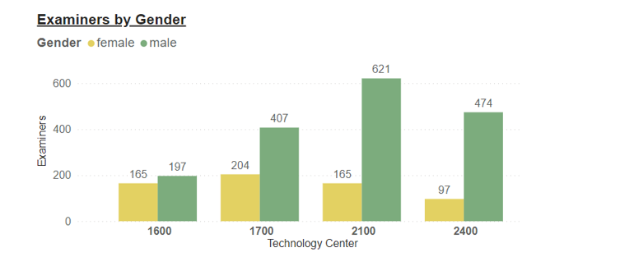
Exploratory Analysis
Number of male examiners exceeds that of females in all technology centers
Centers 1700, 2100, 2400 show low-female and high-male representation
Center 1600 seems more balanced between the two genders

Slide 6
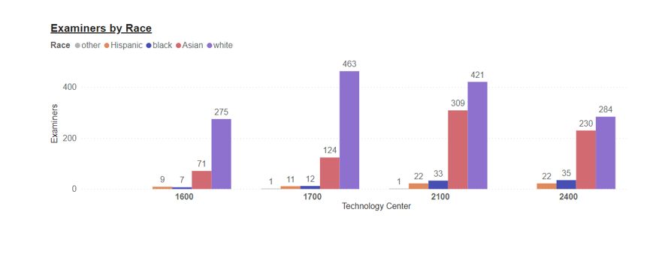
Centers 1600 and 1700 have a predominantly White examiner population, with little representation from Asian groups and even less from Black and Hispanic groups.
Centers 2100 and 2400 have around half of their examiners belonging to the White race, whereas a bit less than half belongs to the Asian race, and the rest is distributed evenly between Black and Hispanic groups.

Slide 7
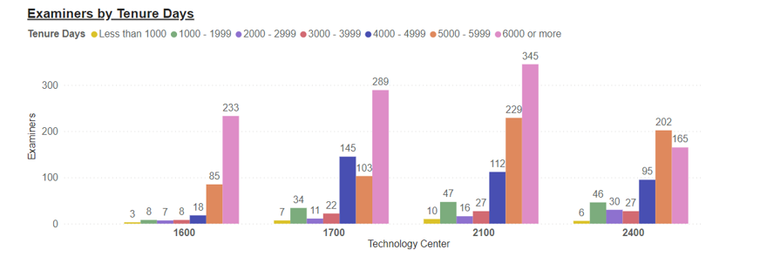
Most examiners across all technology centers have been with the USPTO for 5000 or more tenure days
This trend suggests that most examiners have chosen to remain with the agency for a considerable period, a fact that could speak to the quality of the working environment or the opportunities for career growth and professional development that the USPTO offers.

Slide 8
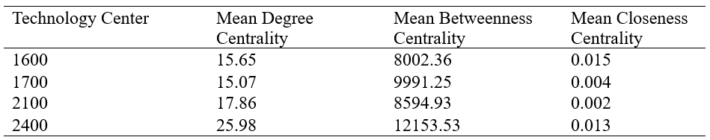

Average centralities

Slide 9
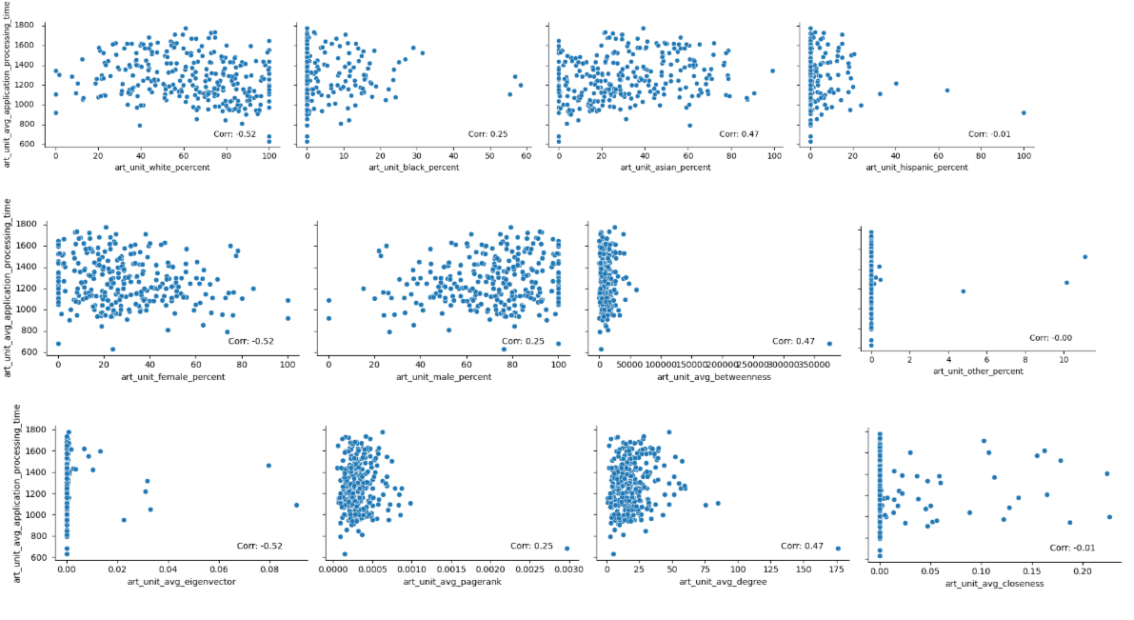
Modeling
Correlation of variables with Processing Time

Slide 10
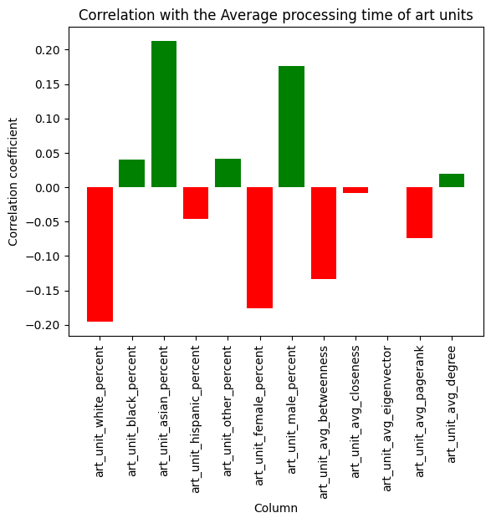
Correlation of variables with Processing Time
The strongest negative correlation was found with the art_unit_white_percent, suggesting that art units with a higher percentage of white examiners tend to have shorter processing times.
The percentage of Asian patent examiners in an art unit increases, the average application processing time also tends to increase
Degree centrality has the highest positive correlation while Pagerank centrality has the highest negative correlation

Slide 11
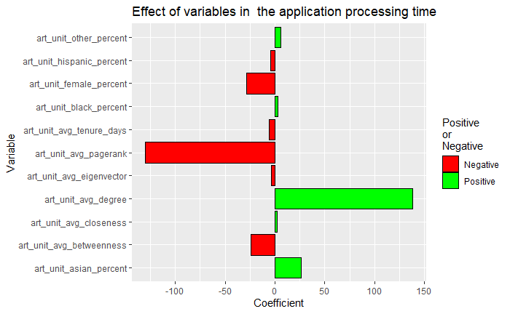
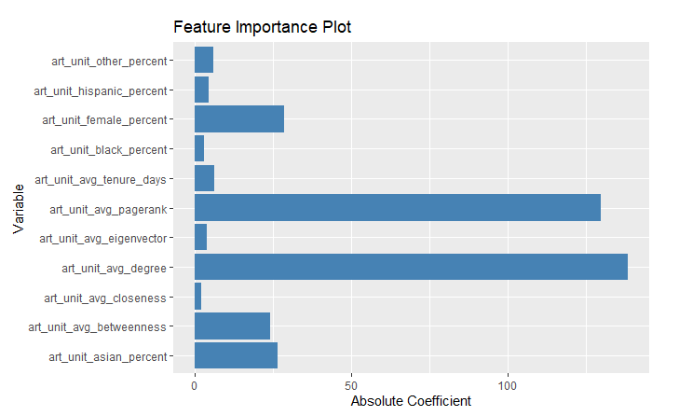
Effect of Variables of the Processing Time
Effect of variables in the application processing time
Feature importance plot

Slide 12




Insights
The average influence of the people within the art unit helps in decreasing the application processing time.
The average influence of people who act as brokers or bridges helps in decreasing the application processing time.
The average effect of presence of people with large number of connections increases the processing time.
The art units with higher percentage of female identifying individuals have faster application processing time.

Slide 13

Recommendation
Convert high degree centrality into high PageRank centrality
Make individuals with high PageRank centrality a point of contact for others in the network
Provide individuals with high degree of centrality with development opportunities
Encourage overall collaboration to generate strong relationships and increase in positive influences
High Degree Centrality = Many Direct Connections | High PageRank Centrality = Influential Connections Also Connected to Influential Individuals
This could lead to: Overwhelmed with sources of information Many requests from others | This could lead to: Resources are more accessible Information is more accurate Positive habits are followed

Slide 14

Conclusion
Leverage individuals with high page rank and betweenness centrality
Monitor the impact of individuals with high degree centrality
Seek to build a diverse workforce that closes the gap between male and female workers

Slide 15
Appendix

Slide 16
Centrality Definitions
Degree Centrality | measures the number of edges that are incident upon a node measure of the importance or significance of a node (or vertex) in a network
Betweenness Centrality | takes into account the number of shortest paths that pass through a node. often called "brokers" or "bridges"
Closeness Centrality | measures the inverse of the average shortest path distance from a node to all other nodes in the network. called "information hubs" because they can quickly disseminate information to other parts of the network
Eigenvector Centrality | measures connection to other highly central nodes in the network. often referred to as "influential nodes" because they have a strong influence on the overall structure and dynamics of the network.
Pagerank centrality | Pagerank centrality is a measure of the influence or importance of a node in a directed network that takes into account the importance of the nodes that point to it.

Slide 17
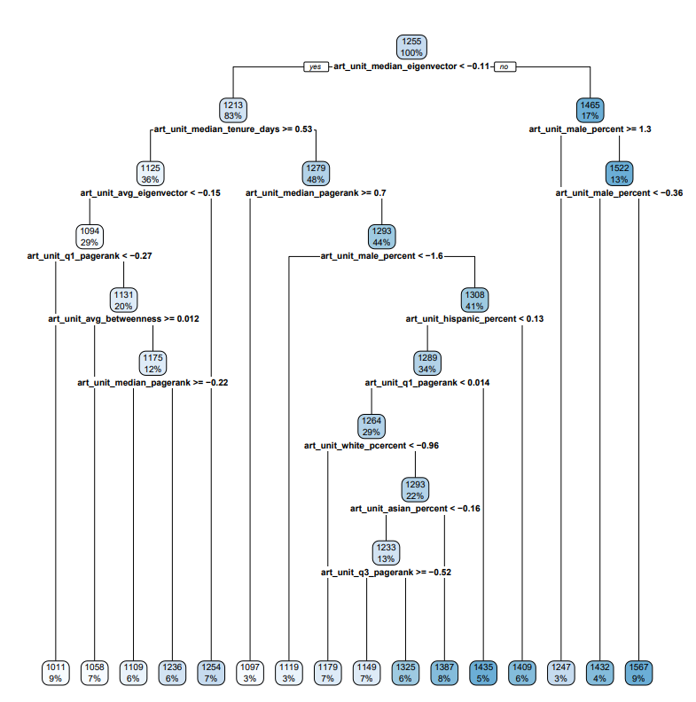
Decision Tree

Slide 18
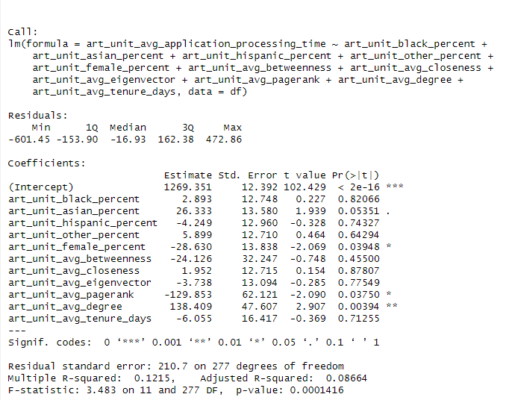
Logistic Regression

Slide 19
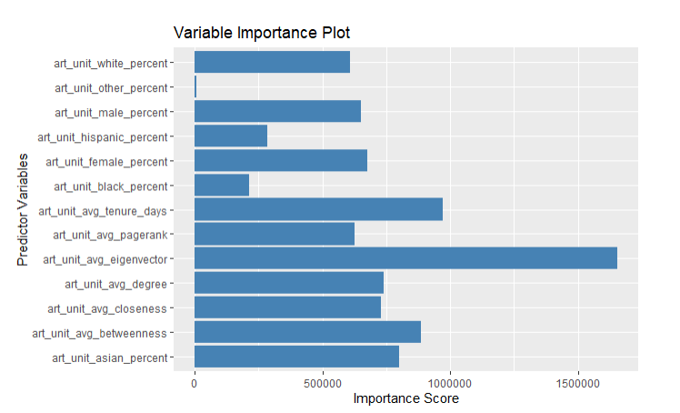
Random Forest

